Slide 1
Git Tutorial

Slide 2
Key Concepts
Components
Reachability
hidden files/folders
3 Areas
.gitignore
Commit
HEAD
Version Control
Branch
Merging
Merge Conflict
Remote Repo
Workflows
Git
Command-line Interface (CLI)

Slide 3
Key Concepts
Components
Reachability
hidden files/folders
3 Areas
.gitignore
Commit
HEAD
Version Control
Branch
Merging
Merge Conflict
Remote Repo
Workflows
Git
Command-line Interface (CLI)

Slide 4
Version Control
Def: “A system that allows you to record the changes
you have made to a file or set of files over time.”

Slide 5
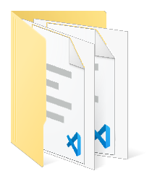
Version Control
Def: “A system that allows you to record the changes
you have made to a file or set of files over time.”
Project

Slide 6
Version Control
Def: “A system that allows you to record the changes
you have made to a file or set of files over time.”
Project
1
2
3
4
5
6

Slide 7
Version Control
Def: “A system that allows you to record the changes
you have made to a file or set of files over time.”
Project
1
2
3
4
5
6
7

Slide 8
Version Control
Def: “A system that allows you to record the changes
you have made to a file or set of files over time.”
Project
1
2
3
4
5
6

Slide 9
Key Concepts
Components
Reachability
hidden files/folders
3 Areas
.gitignore
Commit
HEAD
Version Control
Branch
Merging
Merge Conflict
Remote Repo
Workflows
Git
Command-line Interface (CLI)

Slide 10
Key Concepts
Components
Reachability
hidden files/folders
3 Areas
.gitignore
Commit
HEAD
Version Control
Branch
Merging
Merge Conflict
Remote Repo
Workflows
Git
Command-line Interface (CLI)

Slide 11
Commit
Project
1
2
3
4
5
6

Slide 12
Commit
Project
1
2
3
4
5
6
Saving the state
of the project
Whenever there is a “meaningful“ change

Slide 13
Commit
Project
1
2
3
4
5
6
Saving a file
Whenever you stop working
(or at any arbitrary point in between)
Saving the state
of the project
Whenever there is a “meaningful“ change

Slide 14
Key Concepts
Components
Reachability
hidden files/folders
3 Areas
.gitignore
Commit
HEAD
Version Control
Branch
Merging
Merge Conflict
Remote Repo
Workflows
Git
Command-line Interface (CLI)

Slide 15
Key Concepts
Components
Reachability
hidden files/folders
3 Areas
.gitignore
Commit
HEAD
Version Control
Branch
Merging
Merge Conflict
Remote Repo
Workflows
Git
Command-line Interface (CLI)

Slide 16
Components of a Commit
Project
1
2
3
4
5
6

Slide 17
Components of a Commit
Project
1
2
3
4
5
6
Hash : 24b9da6552252987aa493b52f8696cd6d3b00373
Author: Sebastian Mantey <you@example.com>
Date: Wed Nov 6 10:33:15 2019 +0100
update README

Slide 18
Components of a Commit
Project
1
2
3
4
5
6
Hash : 24b9da6552252987aa493b52f8696cd6d3b00373
Author: Sebastian Mantey <you@example.com>
Date: Wed Nov 6 10:33:15 2019 +0100
update README

Slide 19
Components of a Commit
Project
1
2
3
4
5
6
Hash : 24b9da6552252987aa493b52f8696cd6d3b00373
Author: Sebastian Mantey <you@example.com>
Date: Wed Nov 6 10:33:15 2019 +0100
update README

Slide 20
Components of a Commit
Project
1
2
3
4
5
6
Hash : 24b9da6552252987aa493b52f8696cd6d3b00373
Author: Sebastian Mantey <you@example.com>
Date: Wed Nov 6 10:33:15 2019 +0100
update README

Slide 21
Components of a Commit
Project
1
2
3
4
5
6
Hash : 24b9da6552252987aa493b52f8696cd6d3b00373
Author: Sebastian Mantey <you@example.com>
Date: Wed Nov 6 10:33:15 2019 +0100
update README

Slide 22
Key Concepts
Components
Reachability
hidden files/folders
3 Areas
.gitignore
Commit
HEAD
Version Control
Branch
Merging
Merge Conflict
Remote Repo
Workflows
Git
Command-line Interface (CLI)

Slide 23
Key Concepts
Components
Reachability
hidden files/folders
3 Areas
.gitignore
Commit
HEAD
Version Control
Branch
Merging
Merge Conflict
Remote Repo
Workflows
Git
Command-line Interface (CLI)

Slide 24
Reachability
Project
1
2
3
4
5
7
6

Slide 25
Key Concepts
Components
Reachability
hidden files/folders
3 Areas
.gitignore
Commit
HEAD
Version Control
Branch
Merging
Merge Conflict
Remote Repo
Workflows
Git
Command-line Interface (CLI)

Slide 26
Key Concepts
Components
Reachability
hidden files/folders
3 Areas
.gitignore
Commit
HEAD
Version Control
Branch
Merging
Merge Conflict
Remote Repo
Workflows
Git
Command-line Interface (CLI)

Slide 27
Key Concepts
Components
Reachability
hidden files/folders
3 Areas
.gitignore
Commit
HEAD
Version Control
Branch
Merging
Merge Conflict
Remote Repo
Workflows
Git
Command-line Interface (CLI)

Slide 28
3 Areas
Repository

Slide 29
3 Areas
Repository
1
2
3
4

Slide 30
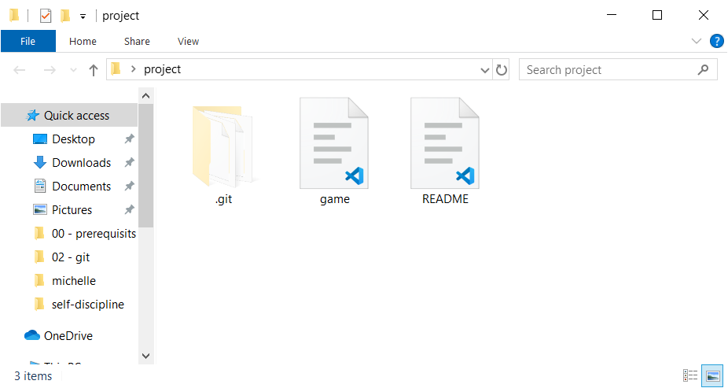
3 Areas
Repository
1
2
3
4

Slide 31
3 Areas
Repository
1
2
3
4

Slide 32
Working Directory
3 Areas
Repository
1
2
3
4

Slide 33
Working Directory
README.md
game.py
3 Areas
Repository
1
2
3
4

Slide 34
Key Concepts
Components
Reachability
hidden files/folders
3 Areas
.gitignore
Commit
HEAD
Version Control
Branch
Merging
Merge Conflict
Remote Repo
Workflows
Git
Command-line Interface (CLI)

Slide 35
Working Directory
README.md
game.py
3 Areas
Repository
1
2
3
4

Slide 36
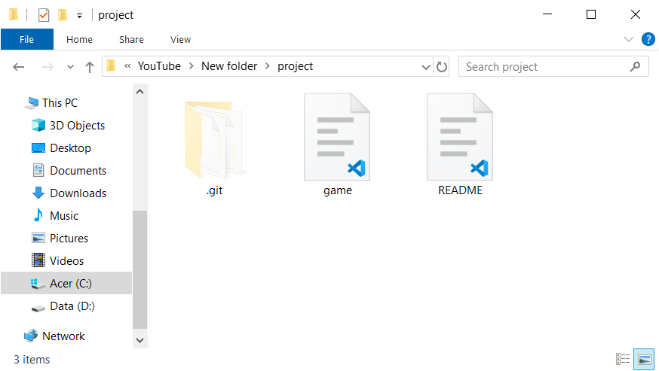
Working Directory
README.md
game.py
3 Areas
Repository
1
2
3
4

Slide 37
Working Directory
README.md
game.py
3 Areas
Repository
1
2
3
4

Slide 38
Working Directory
README.md
game.py
Staging Area
3 Areas
Repository
1
2
3
4

Slide 39
Working Directory
README.md
Staging Area
game.py
3 Areas
Repository
1
2
3
4

Slide 40
Working Directory
README.md
Staging Area
3 Areas
Repository
1
2
3
4
5

Slide 41
Key Concepts
Components
Reachability
hidden files/folders
3 Areas
.gitignore
Commit
HEAD
Version Control
Branch
Merging
Merge Conflict
Remote Repo
Workflows
Git
Command-line Interface (CLI)

Slide 42
Key Concepts
Components
Reachability
hidden files/folders
3 Areas
.gitignore
Commit
HEAD
Version Control
Branch
Merging
Merge Conflict
Remote Repo
Workflows
Git
Command-line Interface (CLI)

Slide 43
Working Directory
__pycache__/
Staging Area
.gitignore
Repository
1
2
3
4
5

Slide 44
Key Concepts
Components
Reachability
hidden files/folders
3 Areas
.gitignore
Commit
HEAD
Version Control
Branch
Merging
Merge Conflict
Remote Repo
Workflows
Git
Command-line Interface (CLI)

Slide 45
Key Concepts
Components
Reachability
hidden files/folders
3 Areas
.gitignore
Commit
HEAD
Version Control
Branch
Merging
Merge Conflict
Remote Repo
Workflows
Git
Command-line Interface (CLI)

Slide 46
Working Directory
Staging Area
Branch
Repository
1
2
3
4

Slide 47
Working Directory
Staging Area
Branch
Repository
1
2
3
4
5
6
7

Slide 48
Working Directory
Staging Area
Branch
Repository
master
1
2
3
4
branch_1
5
6
7

Slide 49
Key Concepts
Components
Reachability
hidden files/folders
3 Areas
.gitignore
Commit
HEAD
Version Control
Branch
Merging
Merge Conflict
Remote Repo
Workflows
Git
Command-line Interface (CLI)

Slide 50
Key Concepts
Components
Reachability
hidden files/folders
3 Areas
.gitignore
Commit
HEAD
Version Control
Branch
Merging
Merge Conflict
Remote Repo
Workflows
Git
Command-line Interface (CLI)

Slide 51
Working Directory
Staging Area
HEAD
Repository
master
HEAD
1
2
3
4
branch_1
5
6
7

Slide 52
Working Directory
Staging Area
HEAD
Repository
HEAD
master
1
2
3
4
branch_1
5
6
7

Slide 53
Working Directory
Staging Area
HEAD
Repository
HEAD
master
1
2
3
4
branch_1
5
6
7

Slide 54
Working Directory
Staging Area
HEAD
Repository
HEAD
master
1
2
3
4
branch_1
5
6
7

Slide 55
Working Directory
Staging Area
HEAD
Repository
HEAD
master
1
2
3
4
8
branch_1
5
6
7

Slide 56
Key Concepts
Components
Reachability
hidden files/folders
3 Areas
.gitignore
Commit
HEAD
Version Control
Branch
Merging
Merge Conflict
Remote Repo
Workflows
Git
Command-line Interface (CLI)

Slide 57
Key Concepts
Components
Reachability
hidden files/folders
3 Areas
.gitignore
Commit
HEAD
Version Control
Branch
Merging
Merge Conflict
Remote Repo
Workflows
Git
Command-line Interface (CLI)

Slide 58
Working Directory
Staging Area
Merging
Repository
HEAD
master
1
2
3
4
branch_1
5
6
7

Slide 59
Working Directory
Staging Area
Merging
fast-forward
three-way
Repository
HEAD
master
1
2
3
4
branch_1
5
6
7

Slide 60
Working Directory
Staging Area
Merging
fast-forward
three-way
Repository
HEAD
master
1
2
3
4
branch_1
5
6
7

Slide 61
Working Directory
Staging Area
Merging
fast-forward
three-way
Repository
HEAD
master
1
2
3
4
branch_1
5
6
7

Slide 62
Working Directory
Staging Area
Merging
fast-forward
three-way
Repository
HEAD
1
2
3
4
master
branch_1
5
6
7

Slide 63
Working Directory
Staging Area
Merging
fast-forward
three-way
Repository
HEAD
master
branch_1
1
2
3
4
5
6
7

Slide 64
Working Directory
Staging Area
Merging
fast-forward
three-way
Repository
HEAD
master
branch_1
1
2
3
4
5
6
7

Slide 65
Working Directory
Staging Area
Merging
fast-forward
three-way
Repository
HEAD
master
1
2
3
4
8
branch_1
5
6
7

Slide 66
Working Directory
Staging Area
Merging
fast-forward
three-way
Repository
HEAD
master
1
2
3
4
8
5
6
7
branch_1

Slide 67
Working Directory
Staging Area
Merging
fast-forward
three-way
Repository
HEAD
master
1
2
3
4
8
9
5
6
7
branch_1

Slide 68
Commit 1
Commit 3
Commit 2

Slide 69
Commit 1
Commit 3
Commit 4
Commit 2

Slide 70
Working Directory
Staging Area
Merging
fast-forward
three-way
Repository
HEAD
master
1
2
3
4
8
9
5
6
7
branch_1

Slide 71
Key Concepts
Components
Reachability
hidden files/folders
3 Areas
.gitignore
Commit
HEAD
Version Control
Branch
Merging
Merge Conflict
Remote Repo
Workflows
Git
Command-line Interface (CLI)

Slide 72
Key Concepts
Components
Reachability
hidden files/folders
3 Areas
.gitignore
Commit
HEAD
Version Control
Branch
Merging
Merge Conflict
Remote Repo
Workflows
Git
Command-line Interface (CLI)

Slide 73
Working Directory
Staging Area
Merge Conflict
Repository
HEAD
master
1
2
3
4
8
9
5
6
7
branch_1

Slide 74
Commit 1
Commit 3
Commit 2

Slide 75
Commit 1
Commit 3
Commit 4
Merge Conflict
Commit 2

Slide 76
Commit 1
Commit 3
Commit 4
Commit 2

Slide 77
Key Concepts
Components
Reachability
hidden files/folders
3 Areas
.gitignore
Commit
HEAD
Version Control
Branch
Merging
Merge Conflict
Remote Repo
Workflows
Git
Command-line Interface (CLI)

Slide 78
Key Concepts
Components
Reachability
hidden files/folders
3 Areas
.gitignore
Commit
HEAD
Version Control
Branch
Merging
Merge Conflict
Remote Repo
Workflows
Git
Command-line Interface (CLI)

Slide 79
Working Directory
Staging Area
Workflows
long-running branches
topic branches
Repository
HEAD
master
1
2
3
4

Slide 80
Working Directory
Staging Area
Workflows
long-running branches
topic branches
Repository
HEAD
master
1
2
3
4

Slide 81
Working Directory
Staging Area
Workflows
long-running branches
topic branches
Repository
HEAD
master
dev
1
2
3
4

Slide 82
Working Directory
Staging Area
Workflows
long-running branches
topic branches
Repository
HEAD
master
dev
1
2
3
4

Slide 83
Working Directory
Staging Area
Workflows
long-running branches
topic branches
Repository
HEAD
master
dev
1
2
3
4
5
6

Slide 84
Working Directory
Staging Area
Workflows
long-running branches
topic branches
Repository
HEAD
master
dev
1
2
3
4
5
6

Slide 85
Working Directory
Staging Area
Workflows
long-running branches
topic branches
Repository
HEAD
master
dev
1
2
3
4
5
6

Slide 86
Working Directory
Staging Area
Workflows
long-running branches
topic branches
Repository
HEAD
master
dev
1
2
3
4
5
6

Slide 87
Working Directory
Staging Area
Workflows
long-running branches
topic branches
Repository
HEAD
master
dev
1
2
3
4
5
6
7
8

Slide 88
Working Directory
Staging Area
Workflows
long-running branches
topic branches
Repository
HEAD
master
dev
1
2
3
4
5
6
7
8

Slide 89
Working Directory
Staging Area
Workflows
long-running branches
topic branches
Repository
HEAD
master
dev
1
2
3
4
5
6
7
8

Slide 90
Working Directory
Staging Area
Workflows
long-running branches
topic branches
Repository
HEAD
master
1
2
3
4

Slide 91
Working Directory
Staging Area
Workflows
long-running branches
topic branches
Repository
HEAD
master
feature
1
2
3
4

Slide 92
Working Directory
Staging Area
Workflows
long-running branches
topic branches
Repository
HEAD
master
feature
1
2
3
4

Slide 93
Working Directory
Staging Area
Workflows
long-running branches
topic branches
Repository
HEAD
master
feature
1
2
3
4
5
6

Slide 94
Working Directory
Staging Area
Workflows
long-running branches
topic branches
Repository
HEAD
master
feature
1
2
3
4
5
6

Slide 95
Working Directory
Staging Area
Workflows
long-running branches
topic branches
Repository
HEAD
master
feature
1
2
3
4
5
6

Slide 96
Working Directory
Staging Area
Workflows
long-running branches
topic branches
Repository
HEAD
master
1
2
3
4
5
6

Slide 97
Working Directory
Staging Area
Workflows
long-running branches
topic branches
Repository
HEAD
master
bug fix
1
2
3
4
5
6

Slide 98
Working Directory
Staging Area
Workflows
long-running branches
topic branches
Repository
HEAD
master
bug fix
1
2
3
4
5
6

Slide 99
Working Directory
Staging Area
Workflows
long-running branches
topic branches
Repository
HEAD
master
bug fix
1
2
3
4
5
6
7
8

Slide 100
Working Directory
Staging Area
Workflows
long-running branches
topic branches
Repository
HEAD
master
bug fix
1
2
3
4
5
6
7
8

Slide 101
Working Directory
Staging Area
Workflows
long-running branches
topic branches
Repository
HEAD
master
bug fix
1
2
3
4
5
6
7
8

Slide 102
Working Directory
Staging Area
Workflows
long-running branches
topic branches
Repository
HEAD
master
1
2
3
4
5
6
7
8

Slide 103
Key Concepts
Components
Reachability
hidden files/folders
3 Areas
.gitignore
Commit
HEAD
Version Control
Branch
Merging
Merge Conflict
Remote Repo
Workflows
Git
Command-line Interface (CLI)

Slide 104
Key Concepts
Components
Reachability
hidden files/folders
3 Areas
.gitignore
Commit
HEAD
Version Control
Branch
Merging
Merge Conflict
Remote Repo
Workflows
Git
Command-line Interface (CLI)

Slide 105
Person 1
Working Directory
Staging Area
Repo

Slide 106
Person 1
Person 2
Working Directory
Working Directory
Staging Area
Staging Area
Repo
Repo

Slide 107
Person 1
Person 2
Working Directory
Working Directory
Staging Area
Staging Area
Repo
Repo
Remote Repo

Slide 108
Person 1
Person 2
Working Directory
Working Directory
Staging Area
Staging Area
Local Repo
Local Repo
Remote Repo

Slide 109


Person 1
Person 2
Working Directory
Working Directory
Staging Area
Staging Area
Local Repo
Local Repo
Remote Repo

Slide 110
Person 1
Person 2
Working Directory
Working Directory
Staging Area
Staging Area
Local Repo
Local Repo
Remote Repo
HEAD
master
1
2
3
4

Slide 111
Person 1
Person 2
Working Directory
Working Directory
Staging Area
Staging Area
Local Repo
Local Repo
HEAD
HEAD
origin/master
master
origin/master
master
1
2
3
4
1
2
3
4
Remote Repo
HEAD
master
1
2
3
4

Slide 112
Person 1
Person 2
Working Directory
Working Directory
Staging Area
Staging Area
Local Repo
Local Repo
HEAD
HEAD
origin/master
master
origin/master
master
1
2
3
4
5
6
1
2
3
4
Remote Repo
HEAD
master
1
2
3
4

Slide 113
Person 1
Person 2
Working Directory
Working Directory
Staging Area
Staging Area
Local Repo
Local Repo
HEAD
HEAD
origin/master
master
origin/master
master
1
2
3
4
5
6
1
2
3
4
Remote Repo
HEAD
master
1
2
3
4
5
6

Slide 114
Person 1
Person 2
Working Directory
Working Directory
Staging Area
Staging Area
Local Repo
Local Repo
HEAD
HEAD
origin/master
master
origin/master
master
1
2
3
4
5
6
1
2
3
4
5
6
Remote Repo
HEAD
master
1
2
3
4
5
6

Slide 115
Working Directory
Staging Area
Local Repository
HEAD
origin/master
master
1
2
3
4
Remote Repository
HEAD
master
1
2
3
4

Slide 116
Key Concepts
Components
Reachability
hidden files/folders
3 Areas
.gitignore
Commit
HEAD
Version Control
Branch
Merging
Merge Conflict
Remote Repo
Workflows
Git
Command-line Interface (CLI)

Slide 117
Key Concepts
Components
Reachability
hidden files/folders
3 Areas
.gitignore
Commit
HEAD
Version Control
Branch
Merging
Merge Conflict
Remote Repo
Workflows
Git
Command-line Interface (CLI)

Slide 118
Key Concepts
Components
Reachability
hidden files/folders
3 Areas
.gitignore
Commit
HEAD
Version Control
Branch
Merging
Merge Conflict
Remote Repo
Workflows
Git
Command-line Interface (CLI)

